Slide 1
COCOAR2 前端Brief

Slide 2
網站架構
首頁
什麼是COCOAR2
公司介紹
最新消息
費用
運用方式
導入實績
x1
x3
x1
x2
x1
x2
x2
COCOAR2的優點
目錄頁
目錄頁
目錄
QR與識別標籤（Marker）圖像的不同
文章內頁
內頁
(6個內容排版)
案例
外部連結
下載APP
客人心聲
內頁
詢問表單x1
相關連結
中文版

Slide 3
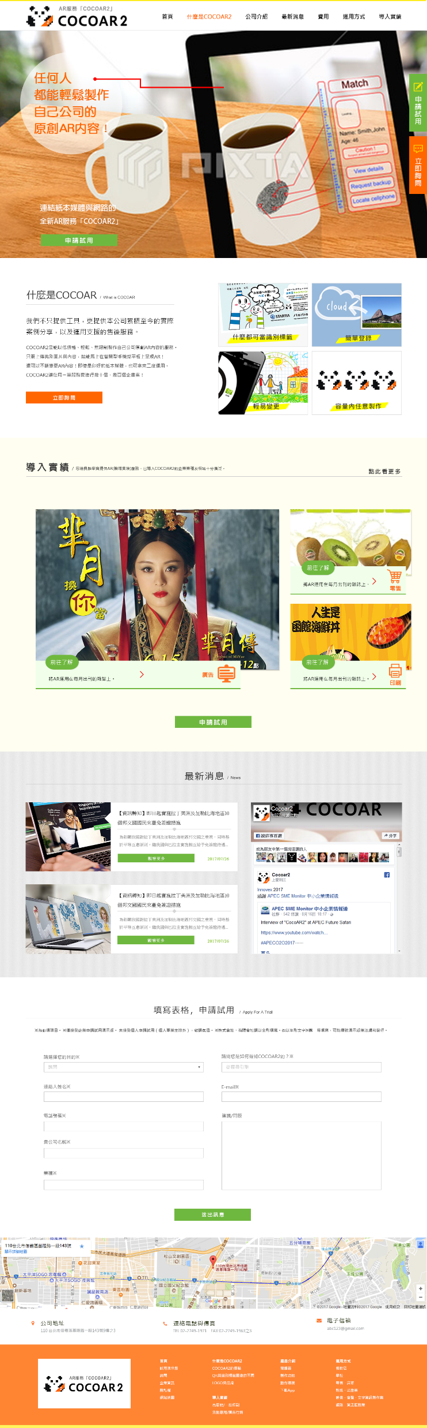
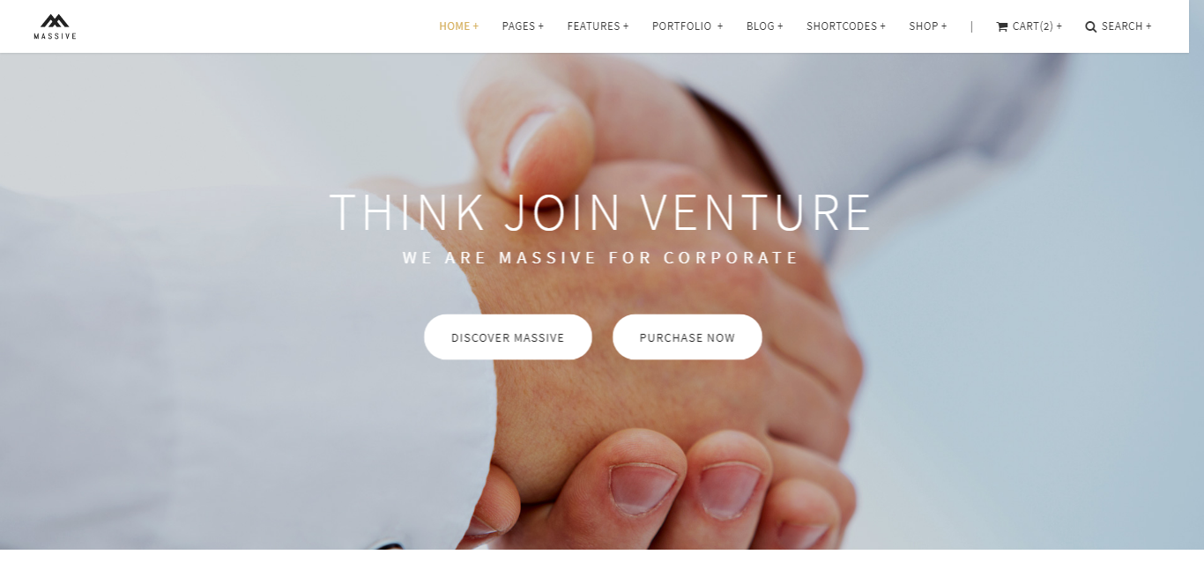
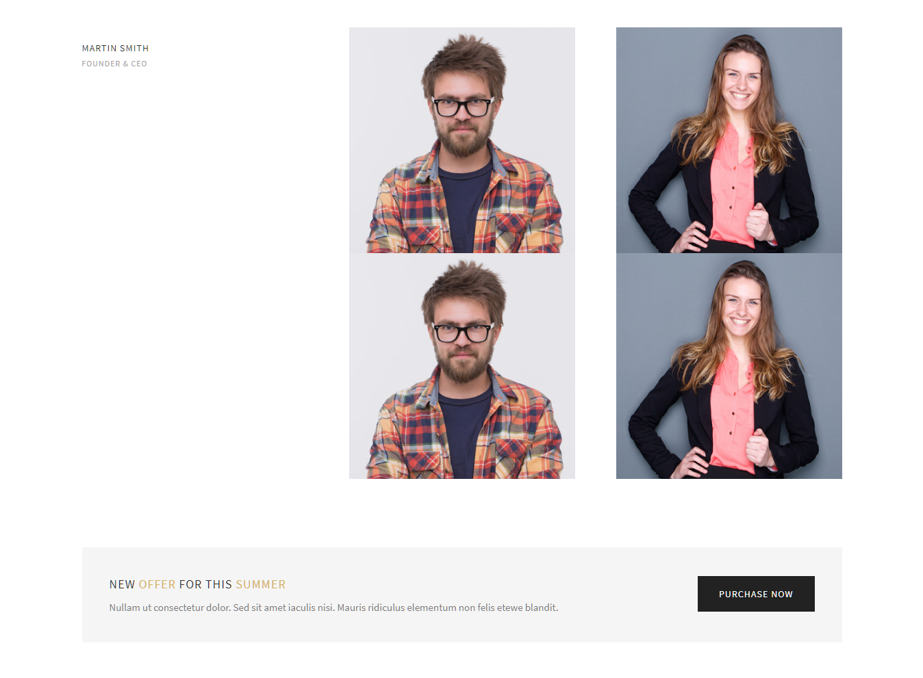
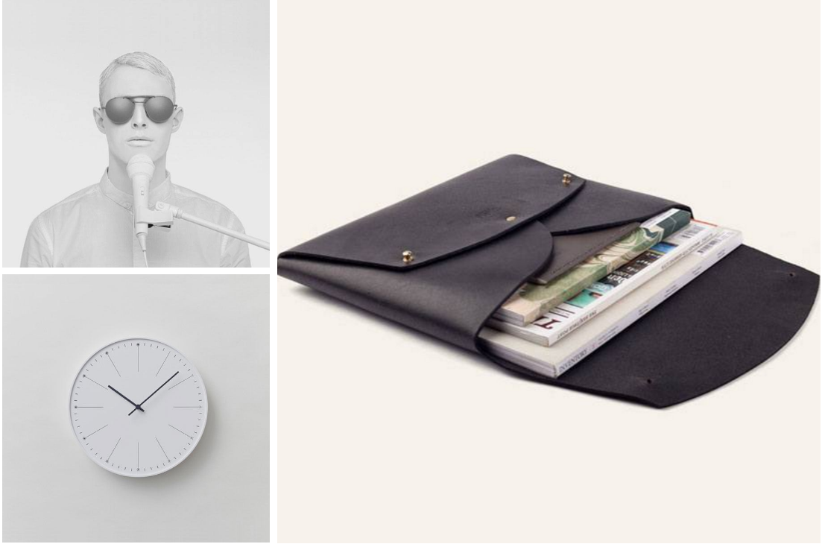
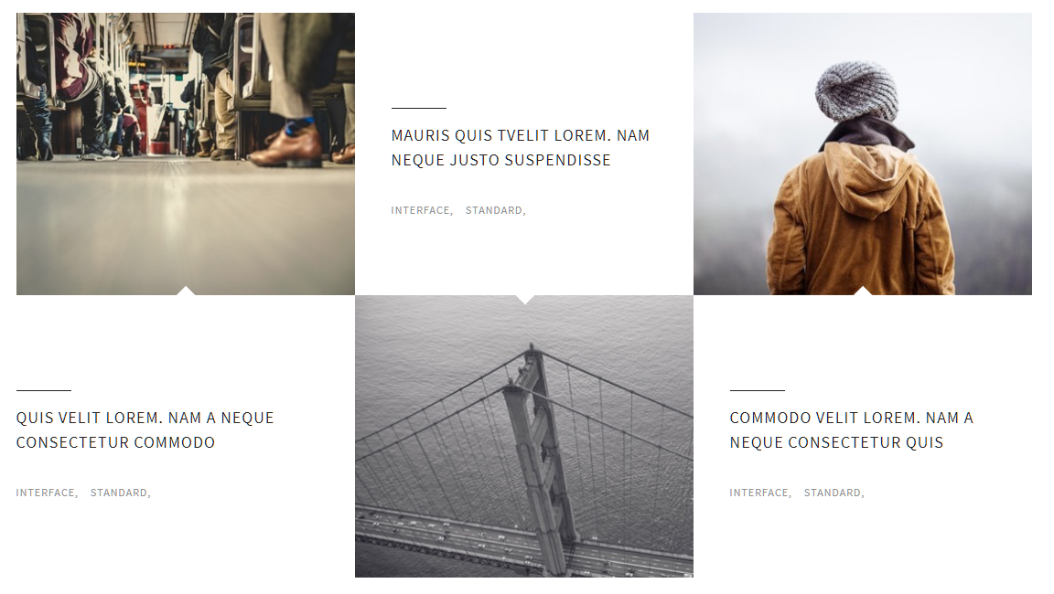
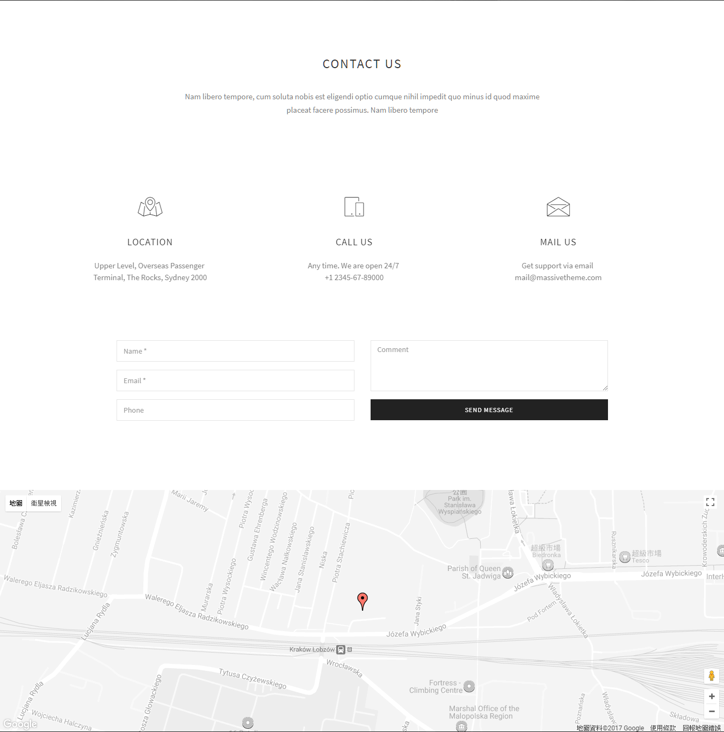
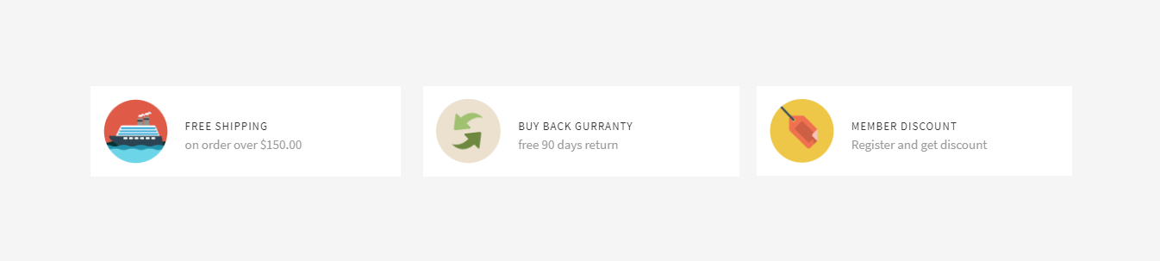
0-0首頁
http://massive.markup.themebucket.net/mp-index-corporate-2.html
http://massive.markup.themebucket.net/our-team-2.html
http://massive.markup.themebucket.net/gallery-masonry.html
http://massive.markup.themebucket.net/mp-index-creative-3.html
http://massive.markup.themebucket.net/mp-index-restaurant.html
http://massive.markup.themebucket.net/mp-index-fashion.html

Slide 4
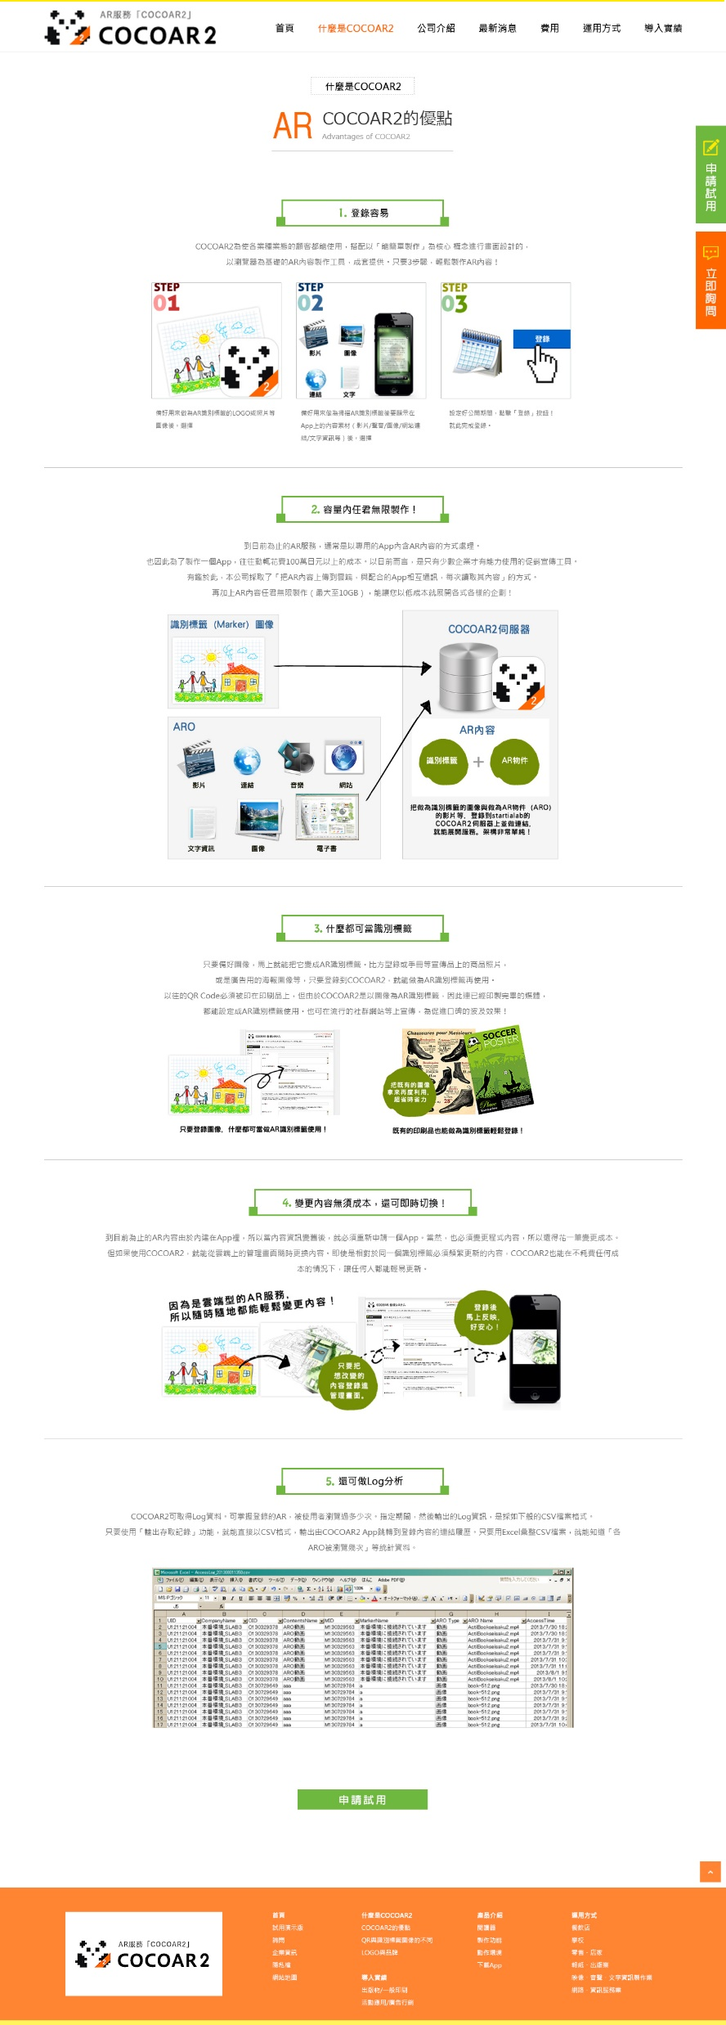
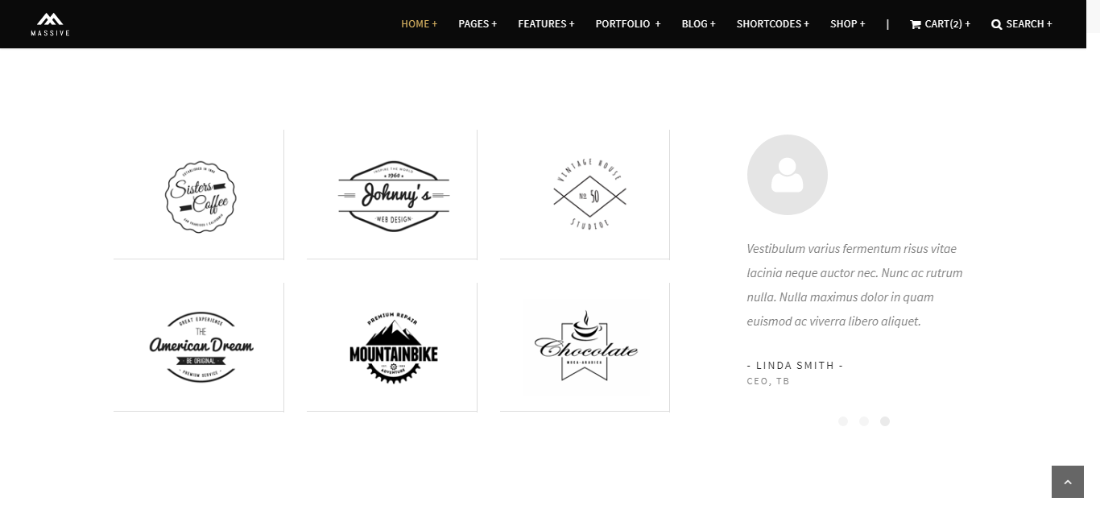
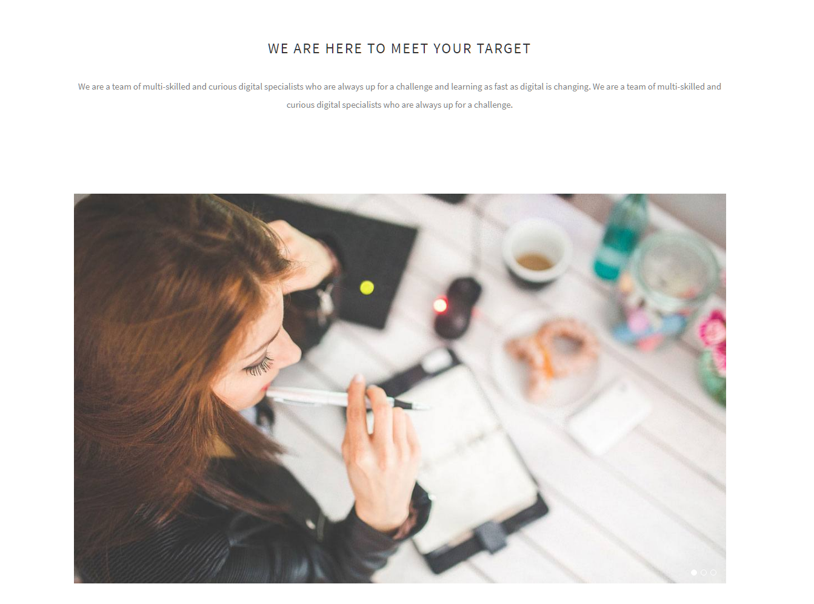
1-1什麼是 COCOAR2 _ COCOAR2的優點
http://massive.markup.themebucket.net/mp-index-general-1.html
http://massive.markup.themebucket.net/about-us-2.html
http://massive.markup.themebucket.net/mp-index-general-1.html

Slide 5
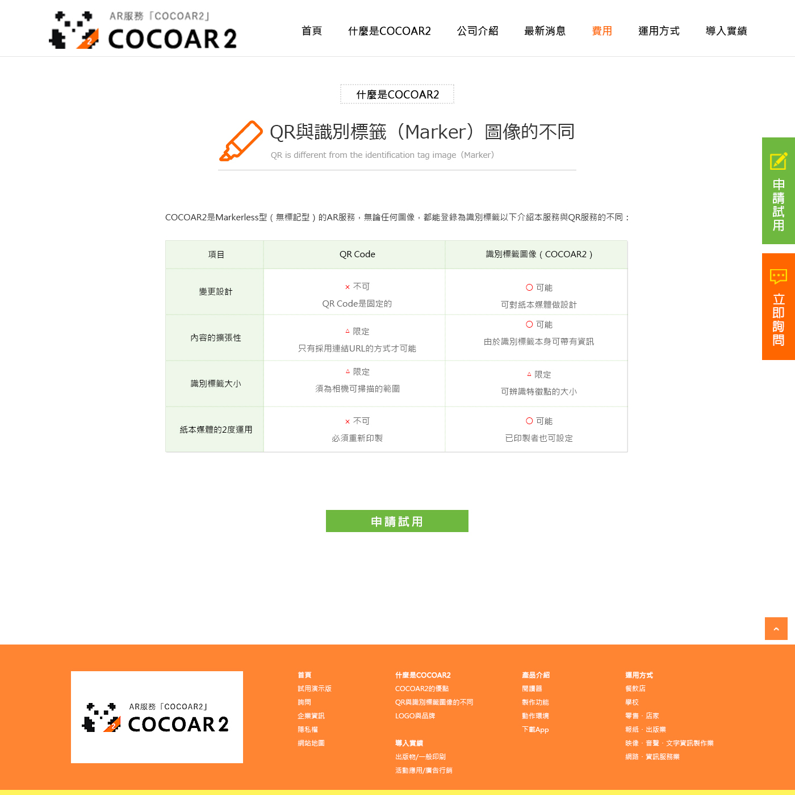
1-2什麼是COCOAR2_QR與識別標籤（Marker）圖像的不同
http://massive.markup.themebucket.net/about-us-2.html

Slide 6
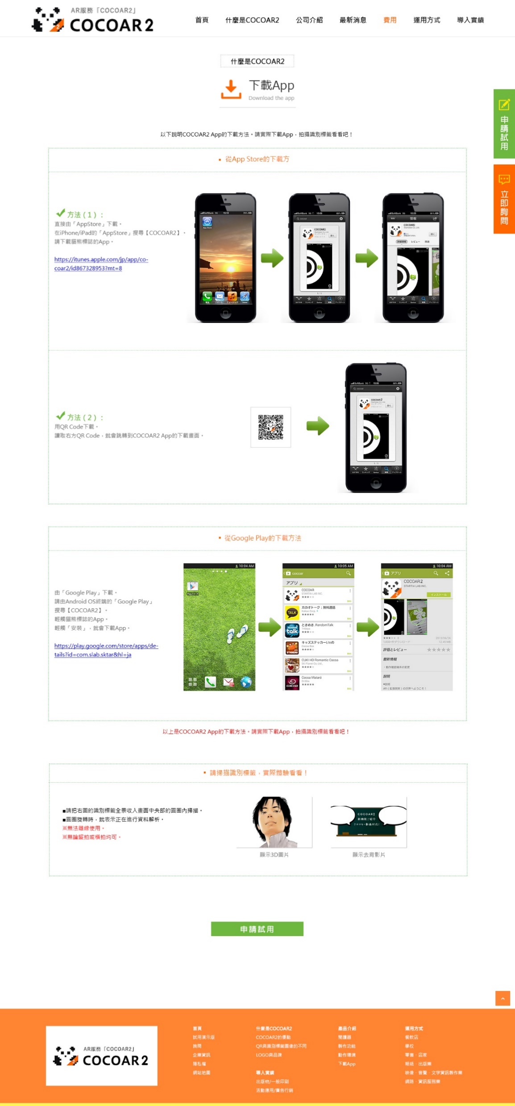
1-3什麼是COCOAR2_下載APP
http://massive.markup.themebucket.net/mp-index-general-1.html

Slide 7
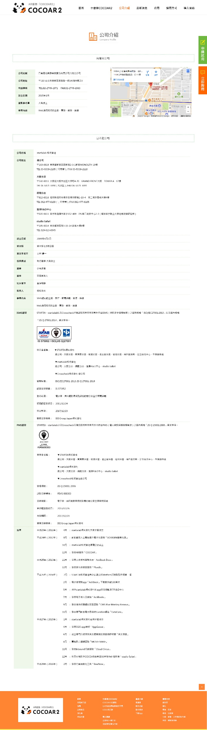
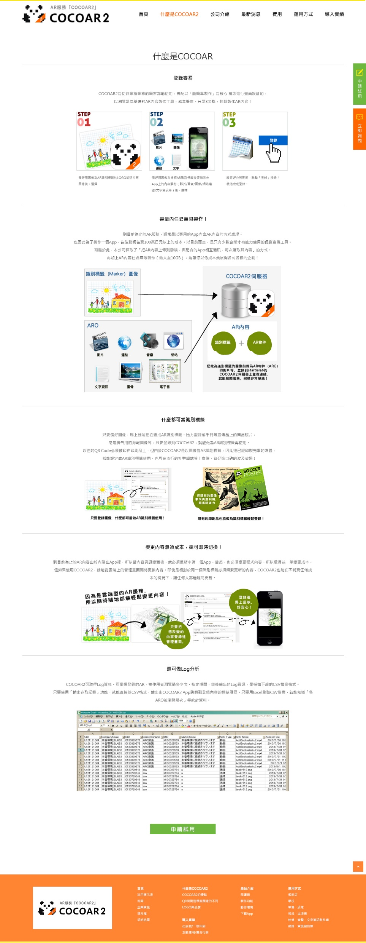
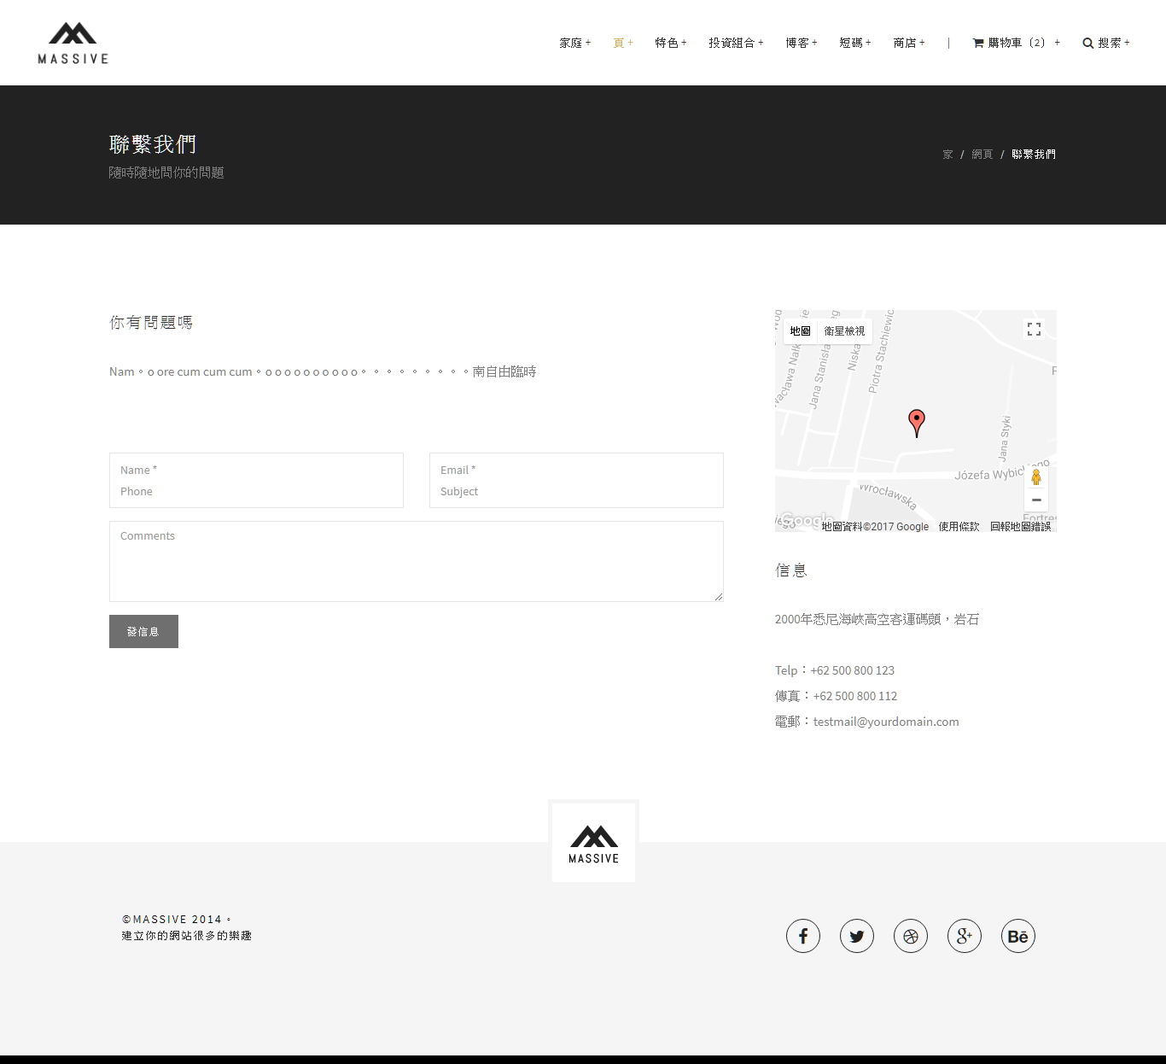
2-1公司介紹
漏掉
http://massive.markup.themebucket.net/contact-us-2.html

Slide 8
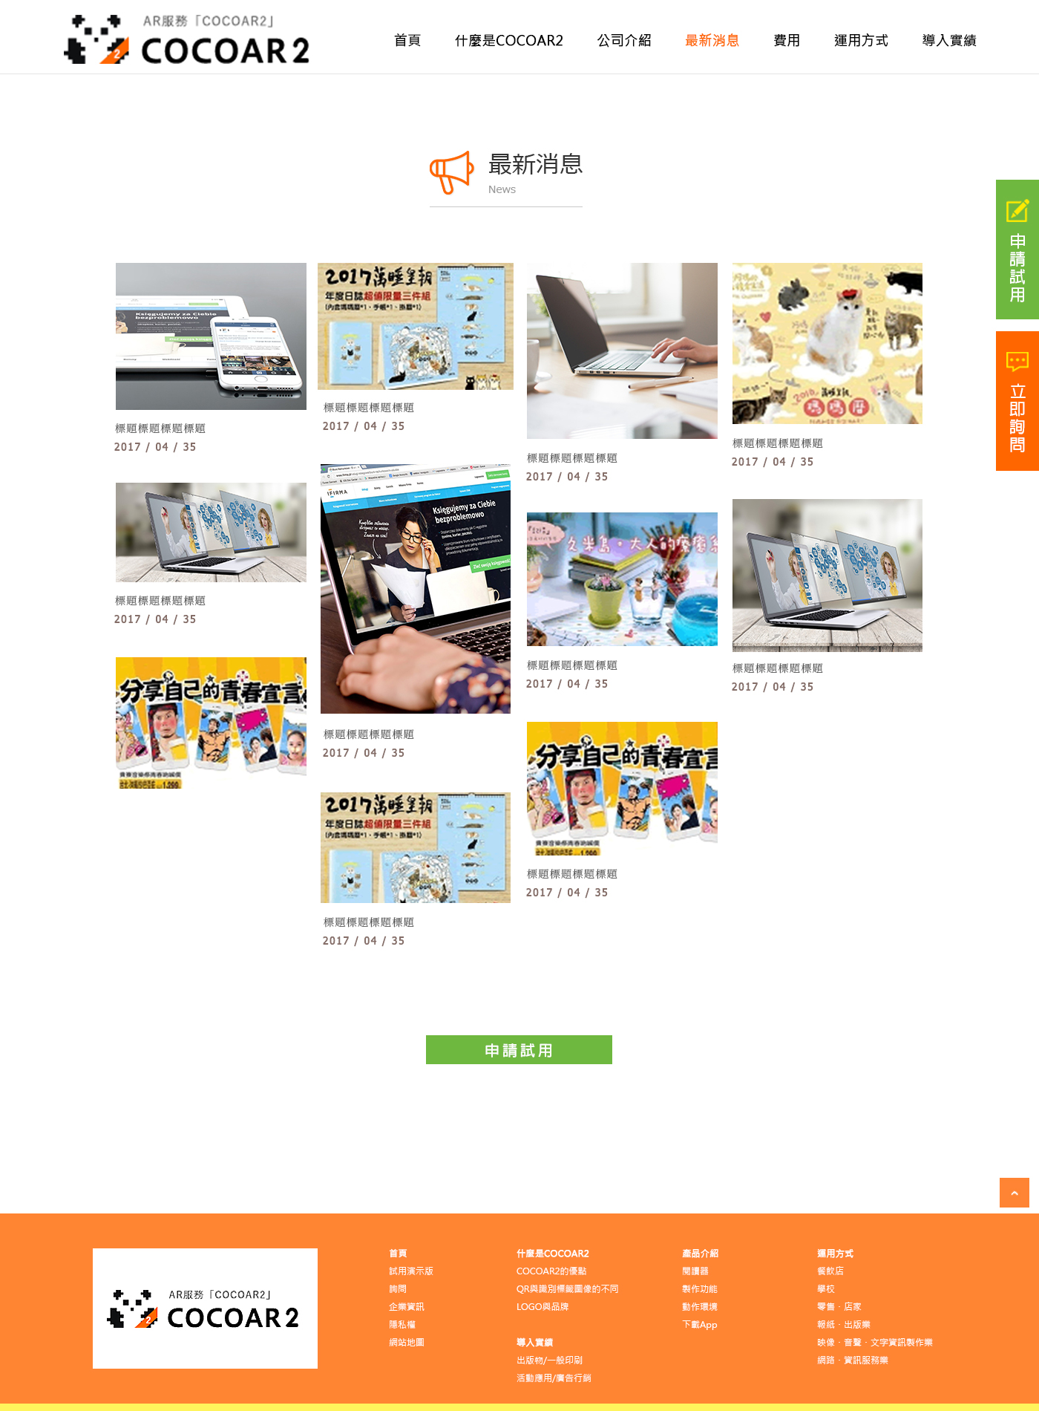
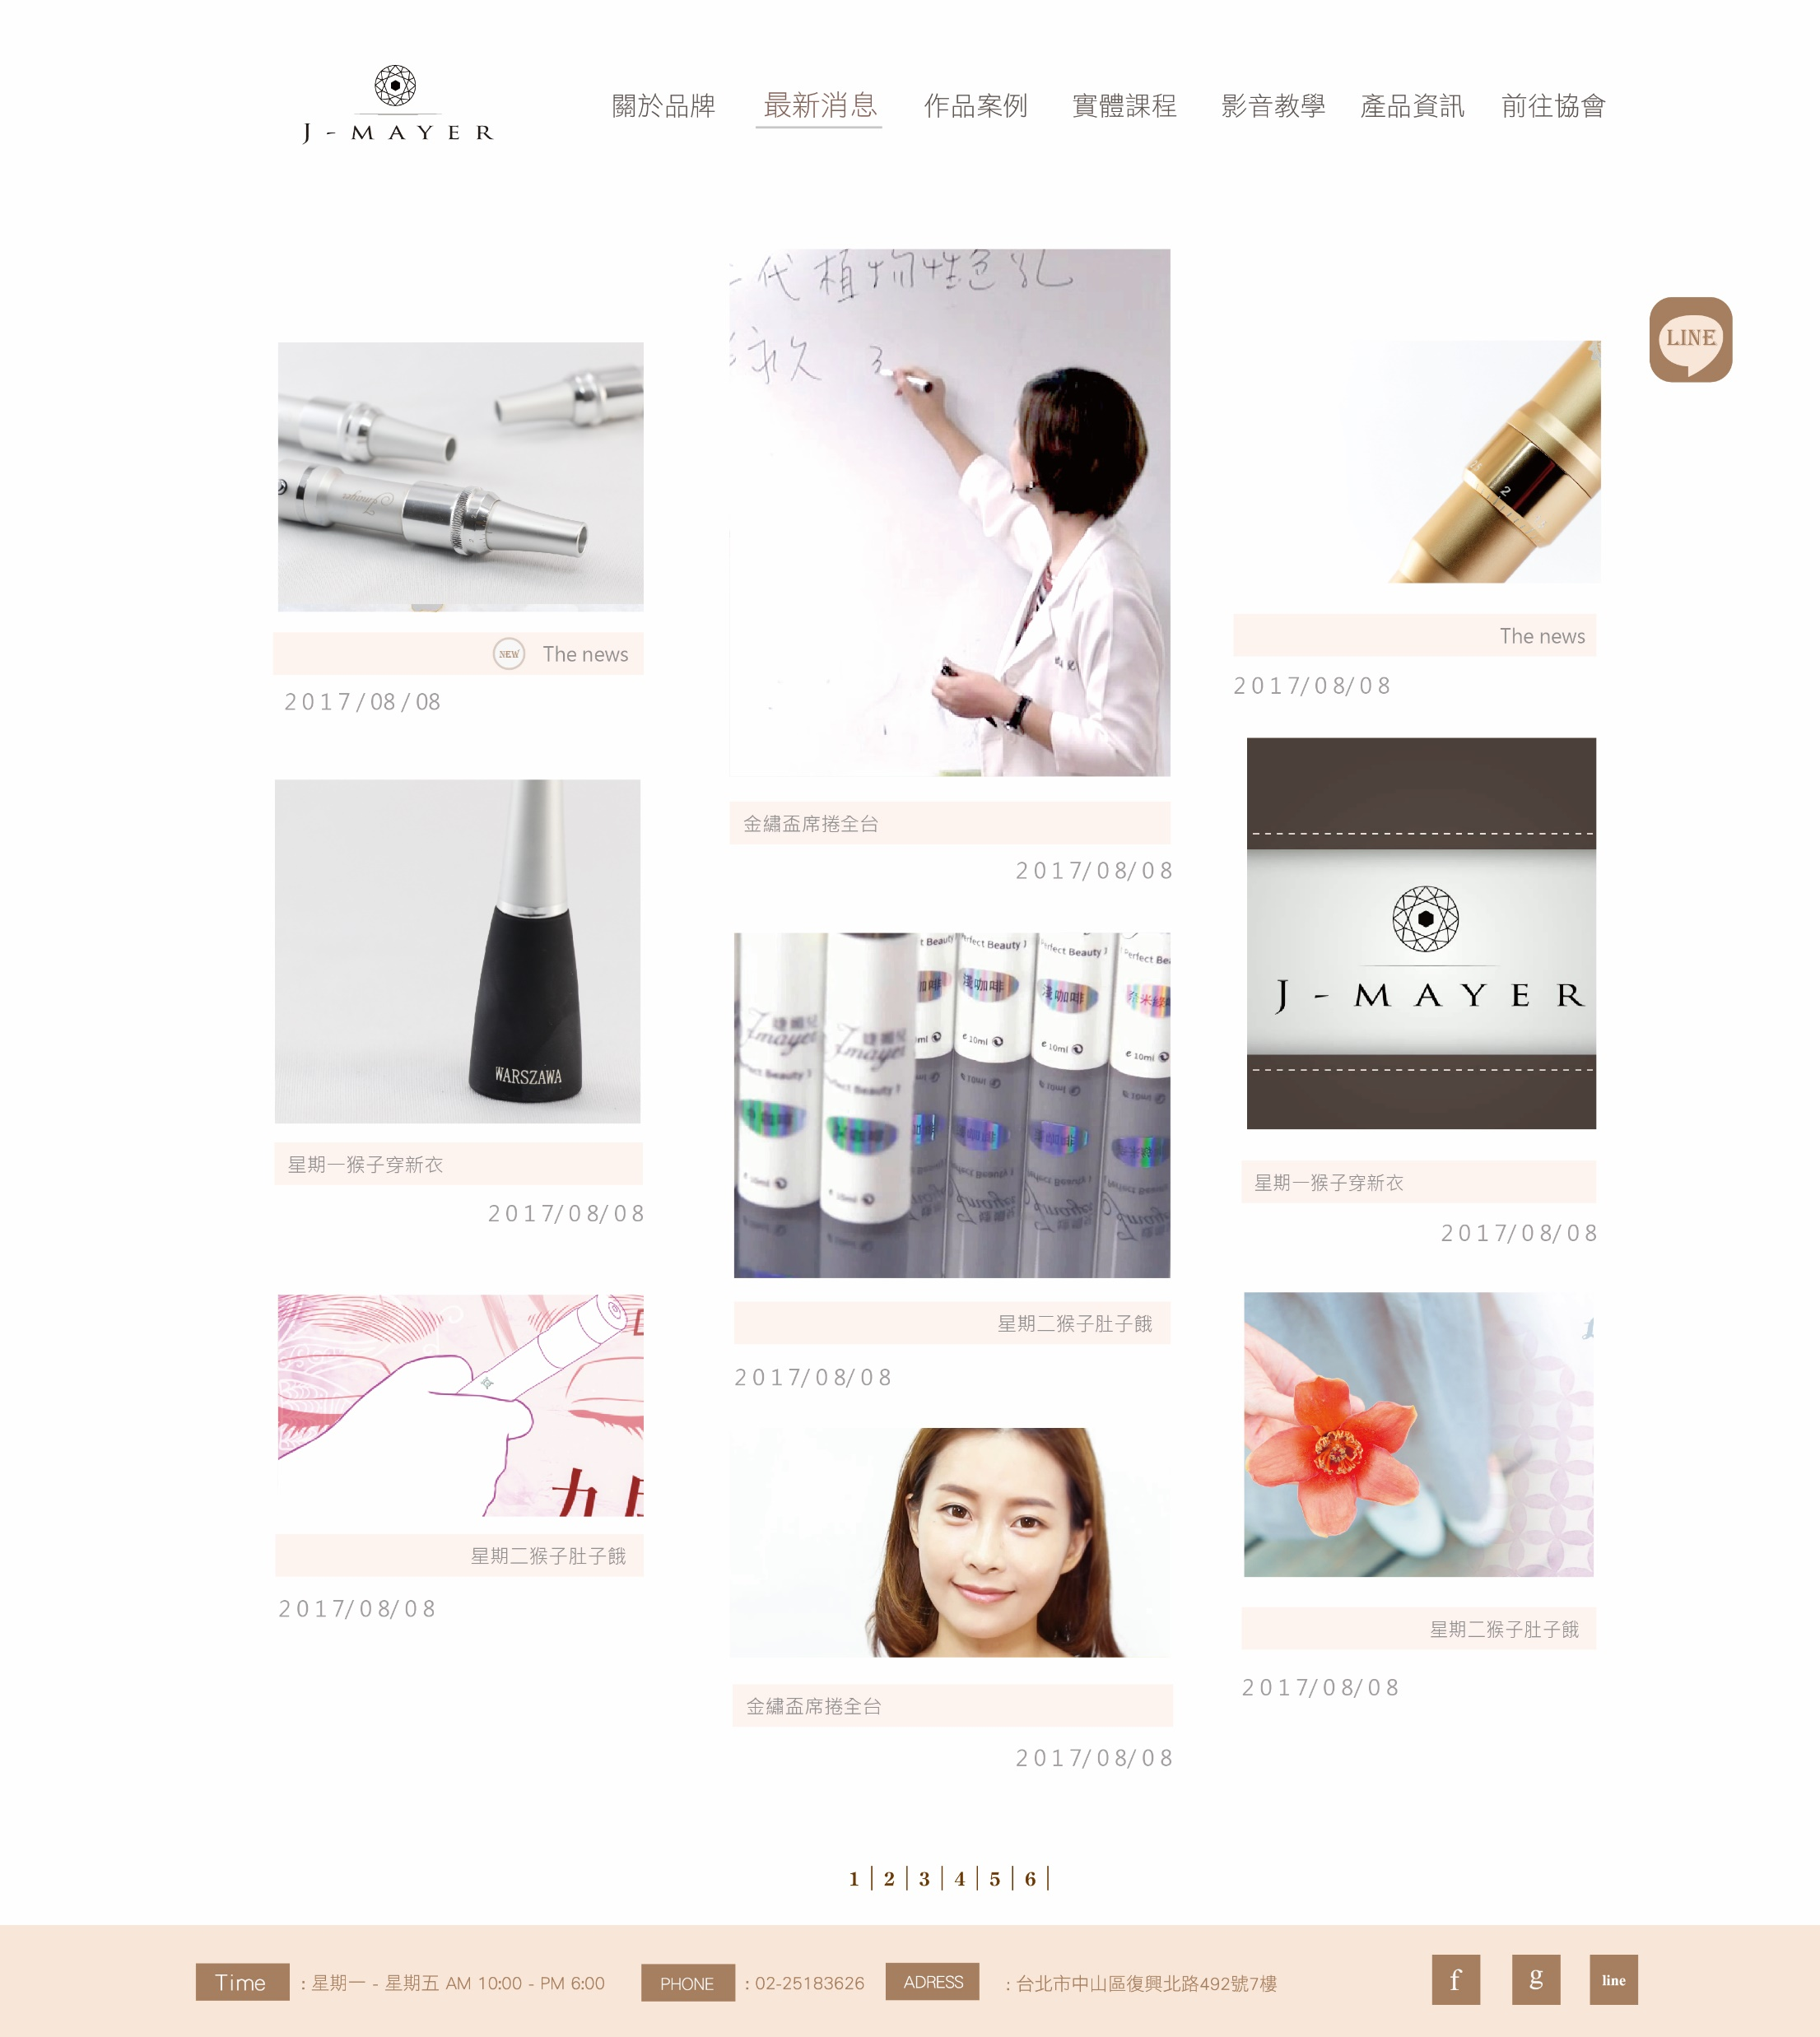
3-1最新消息_目錄頁
http://massive.markup.themebucket.net/portfolio-4-masonry-title-fullwidth.html

Slide 9
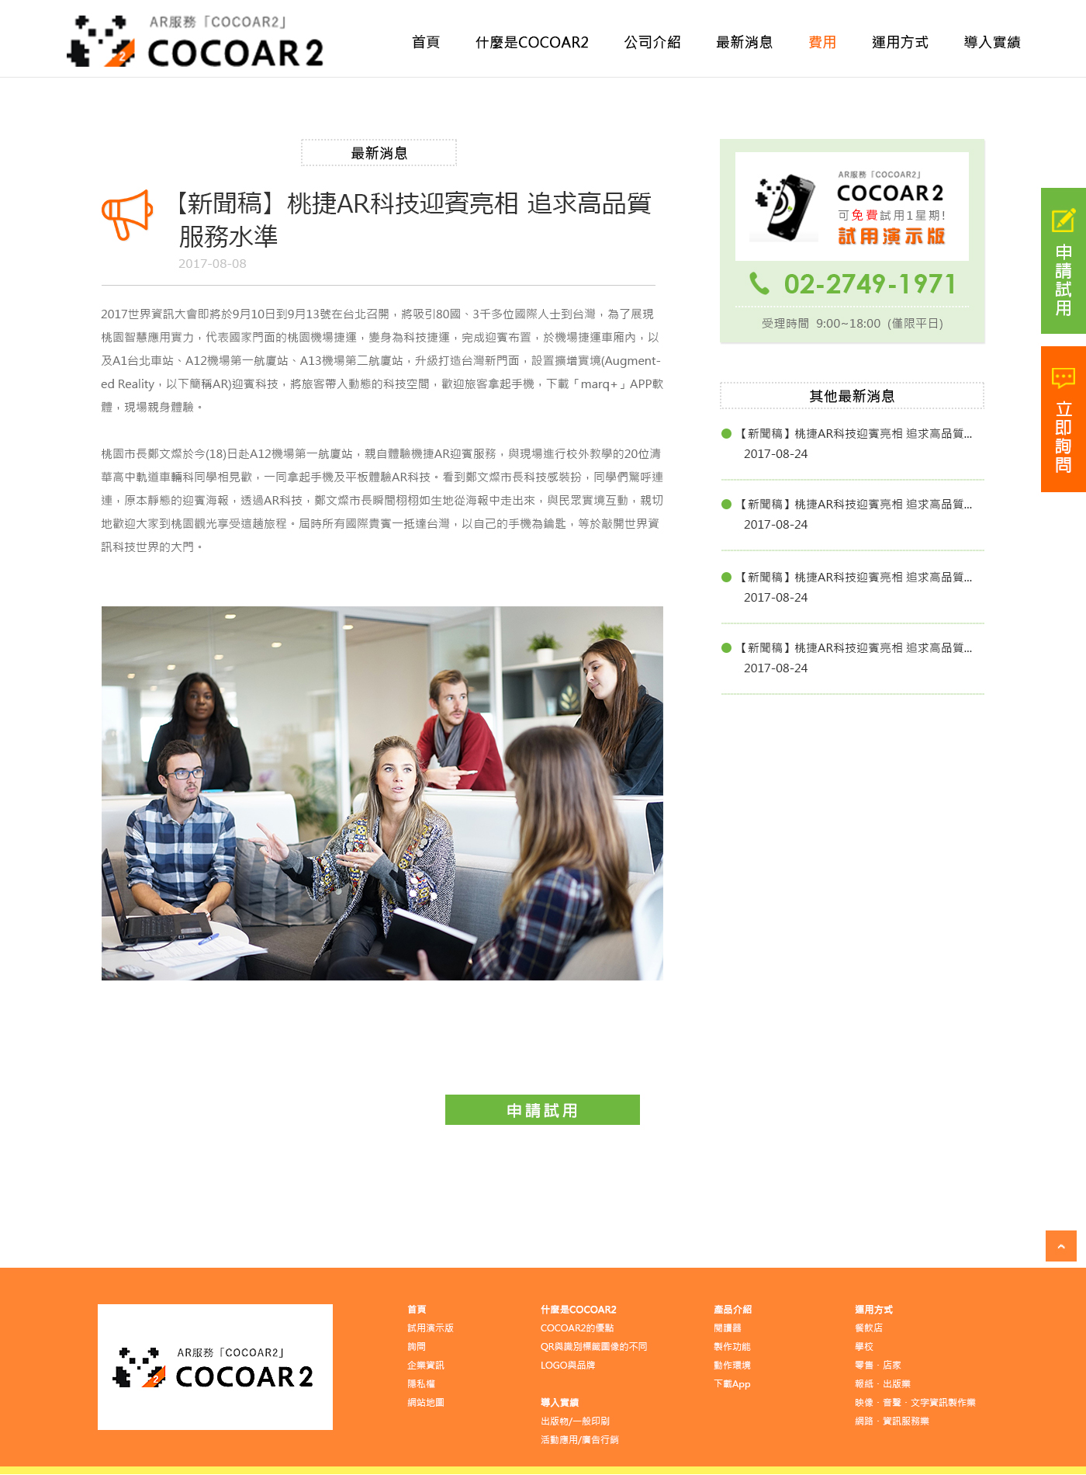
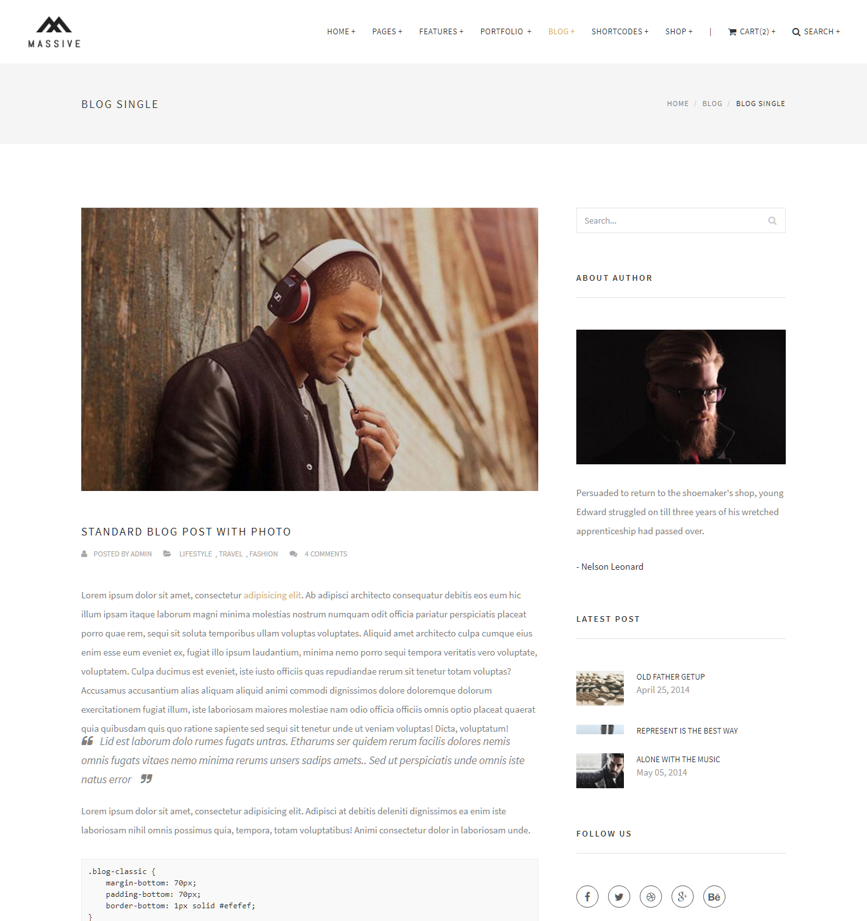
3-2最新消息_文章內頁
http://massive.markup.themebucket.net/blog-single.html

Slide 10
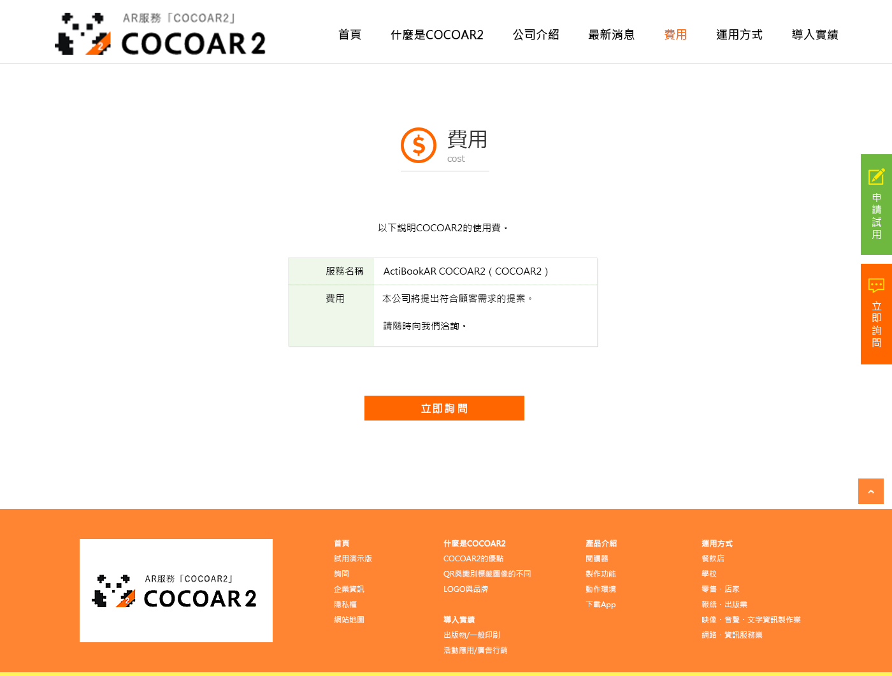
4-1費用
http://massive.markup.themebucket.net/about-us-2.html

Slide 11
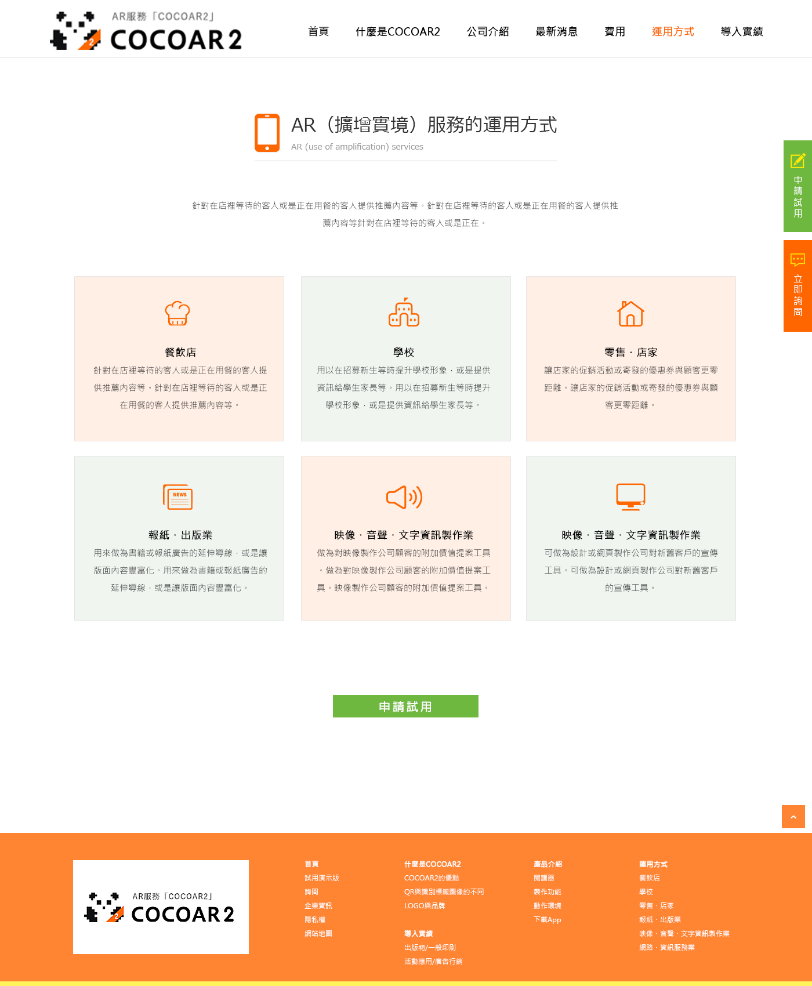
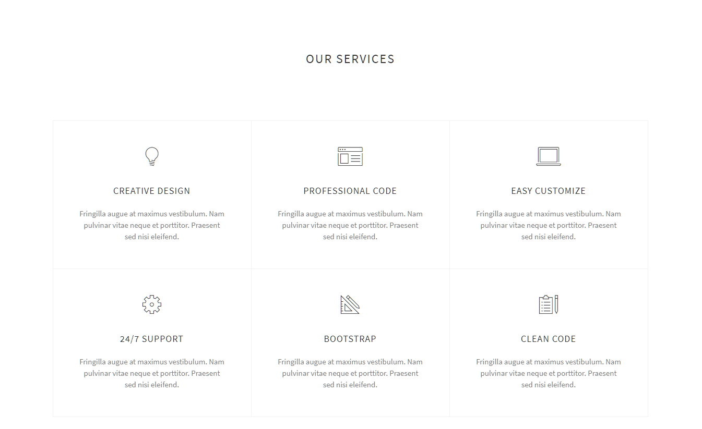
5-1運用方式
http://massive.markup.themebucket.net/mp-index-corporate-1.html

Slide 12
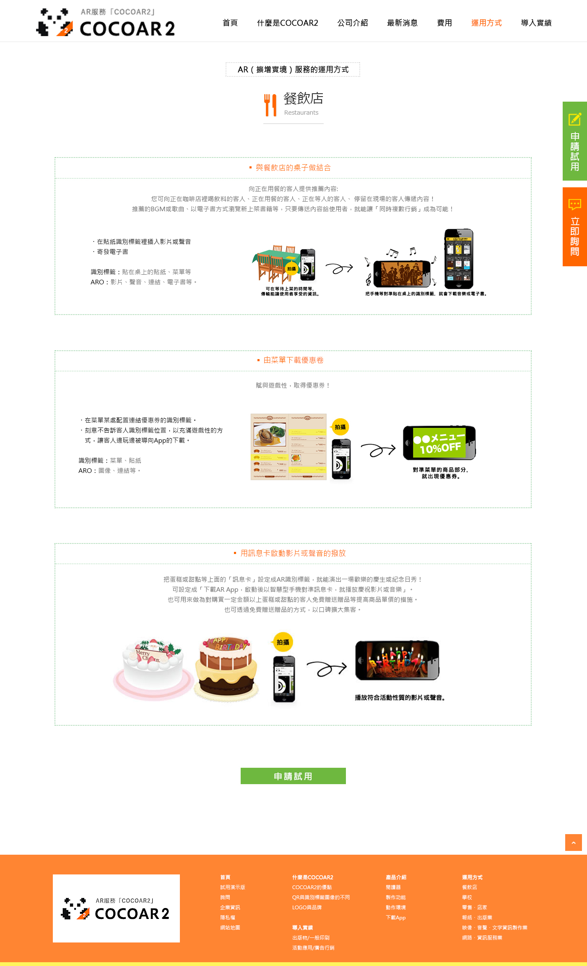
5-2運用方式-內頁
http://massive.markup.themebucket.net/mp-index-general-1.html

Slide 13
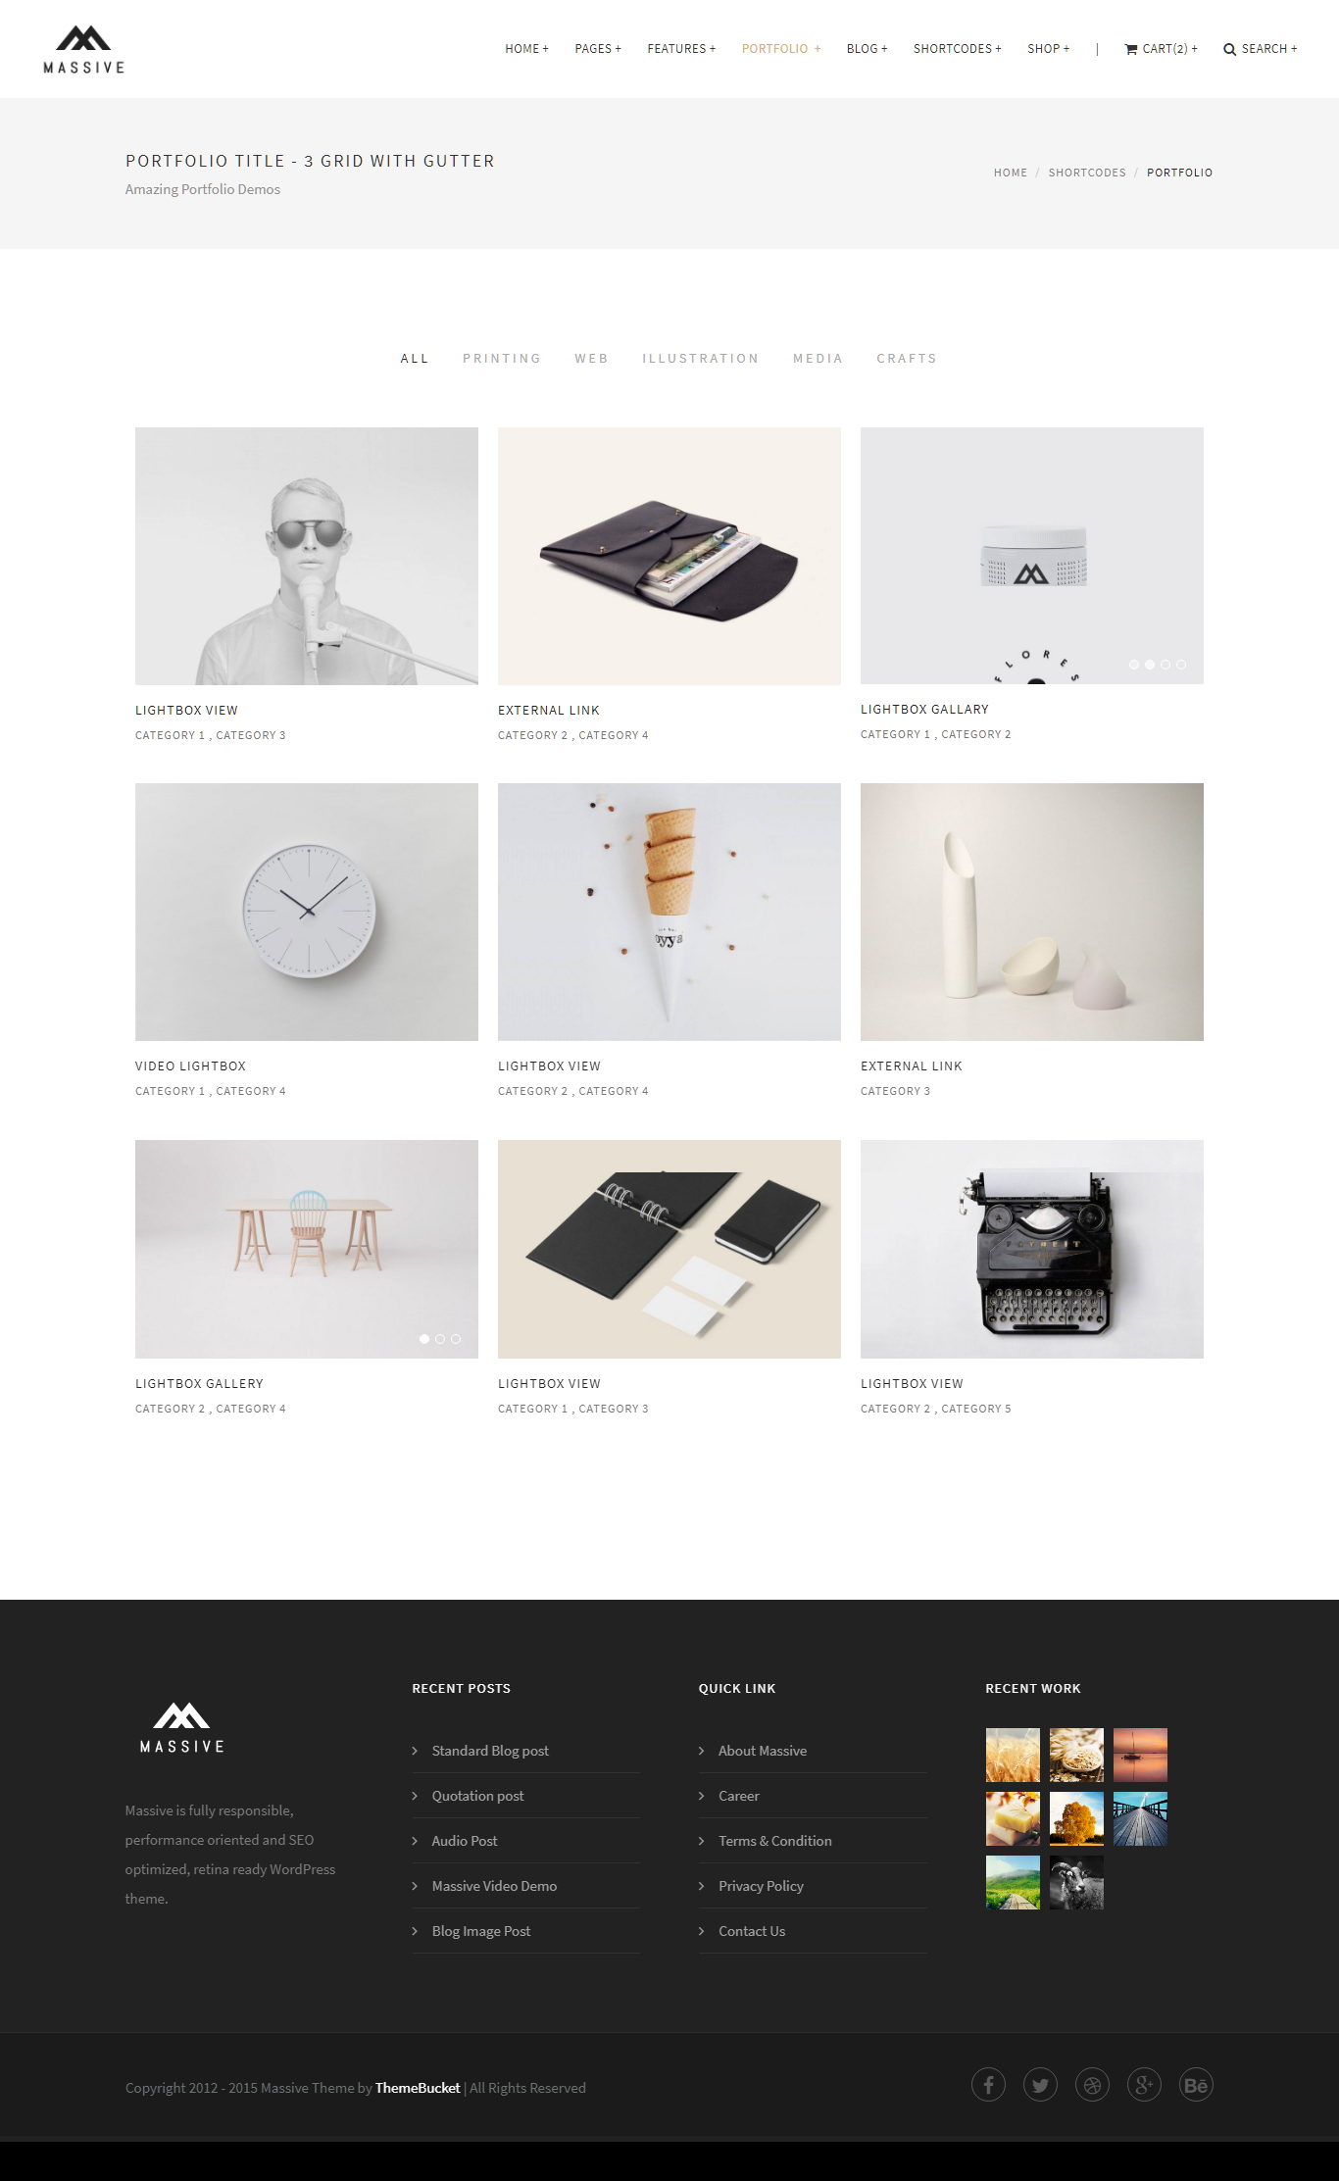
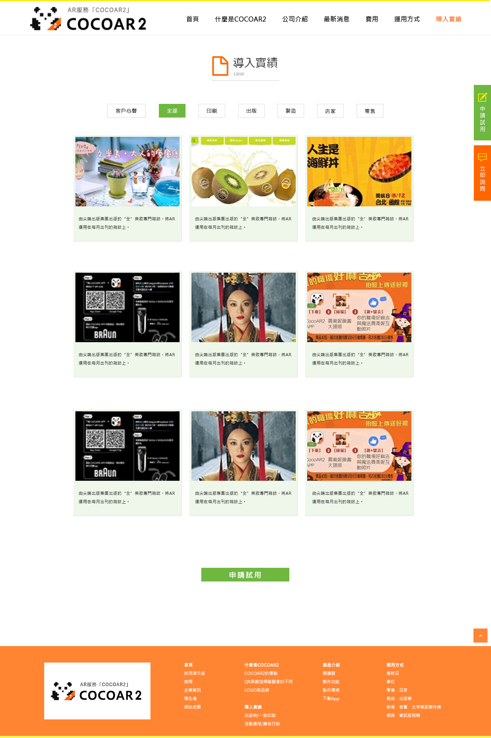
6-1導入實績_目錄頁
http://massive.markup.themebucket.net/portfolio-3-title.html

Slide 14
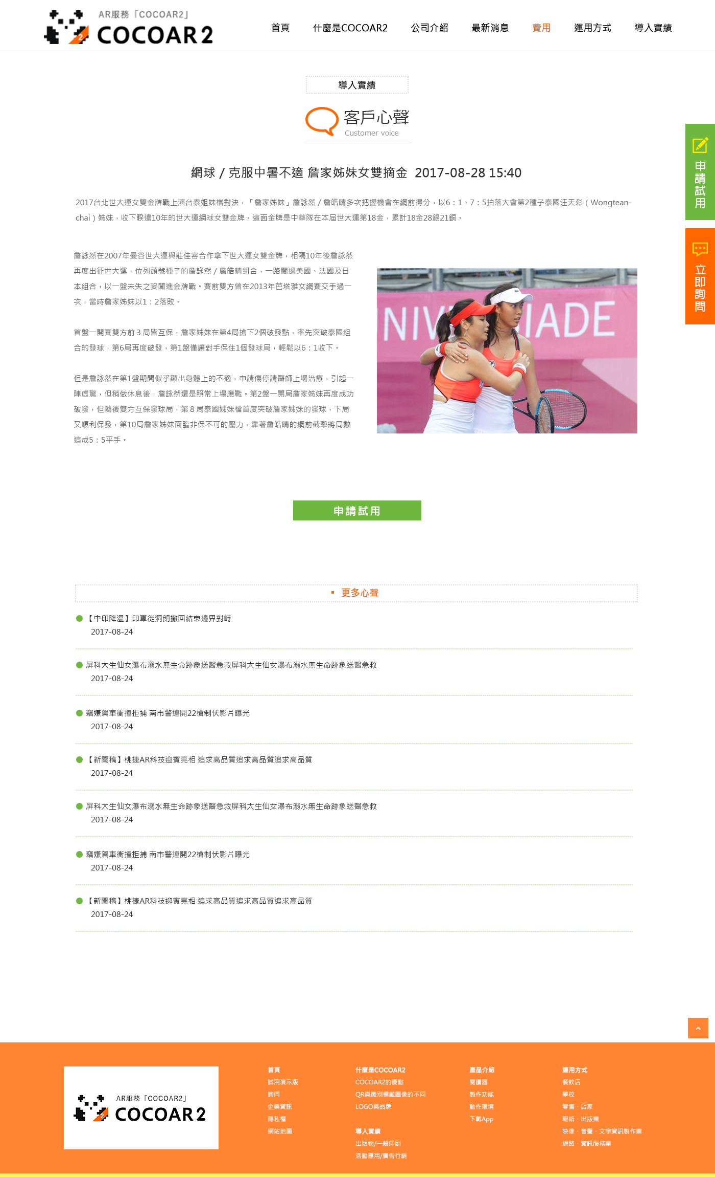
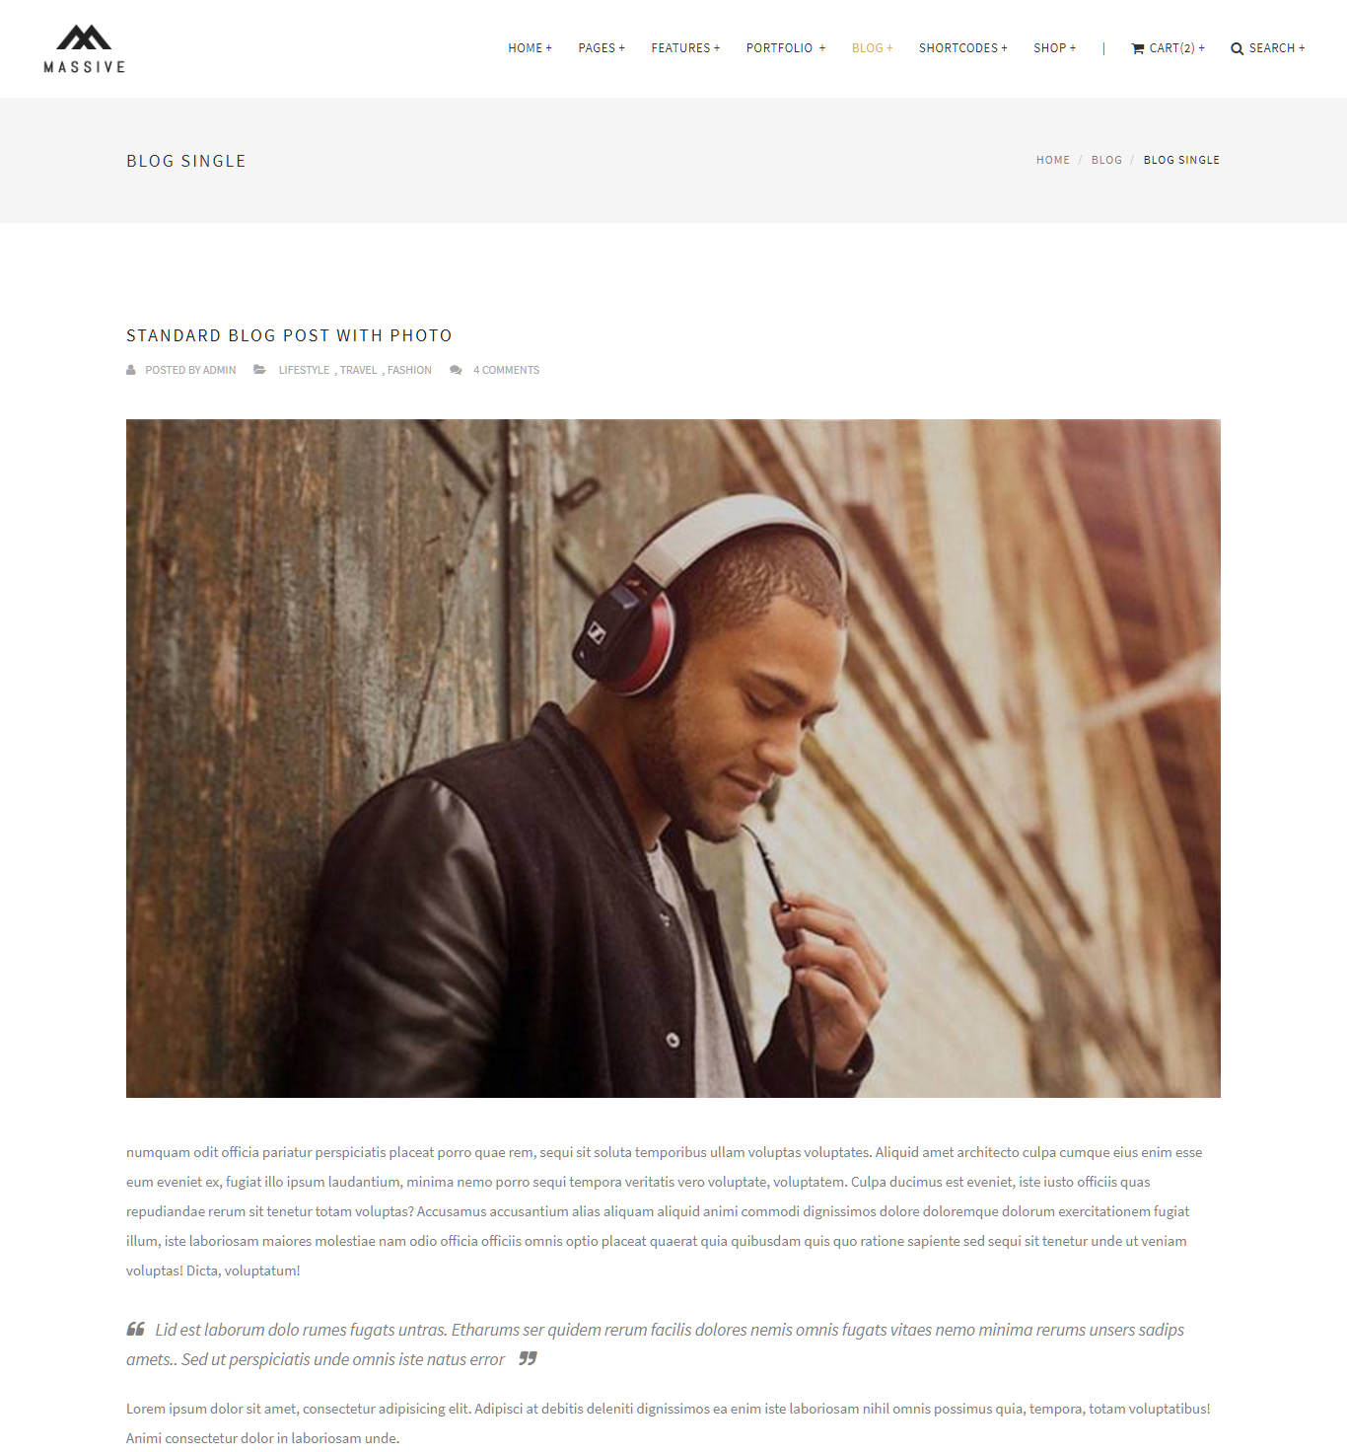
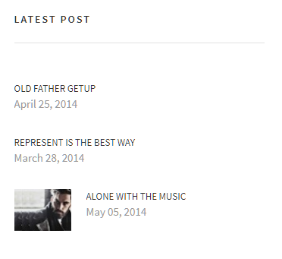
6-2導入實績_客戶心聲頁
http://massive.markup.themebucket.net/blog-single-fullwidth.html
http://massive.markup.themebucket.net/blog-single.html

Slide 15
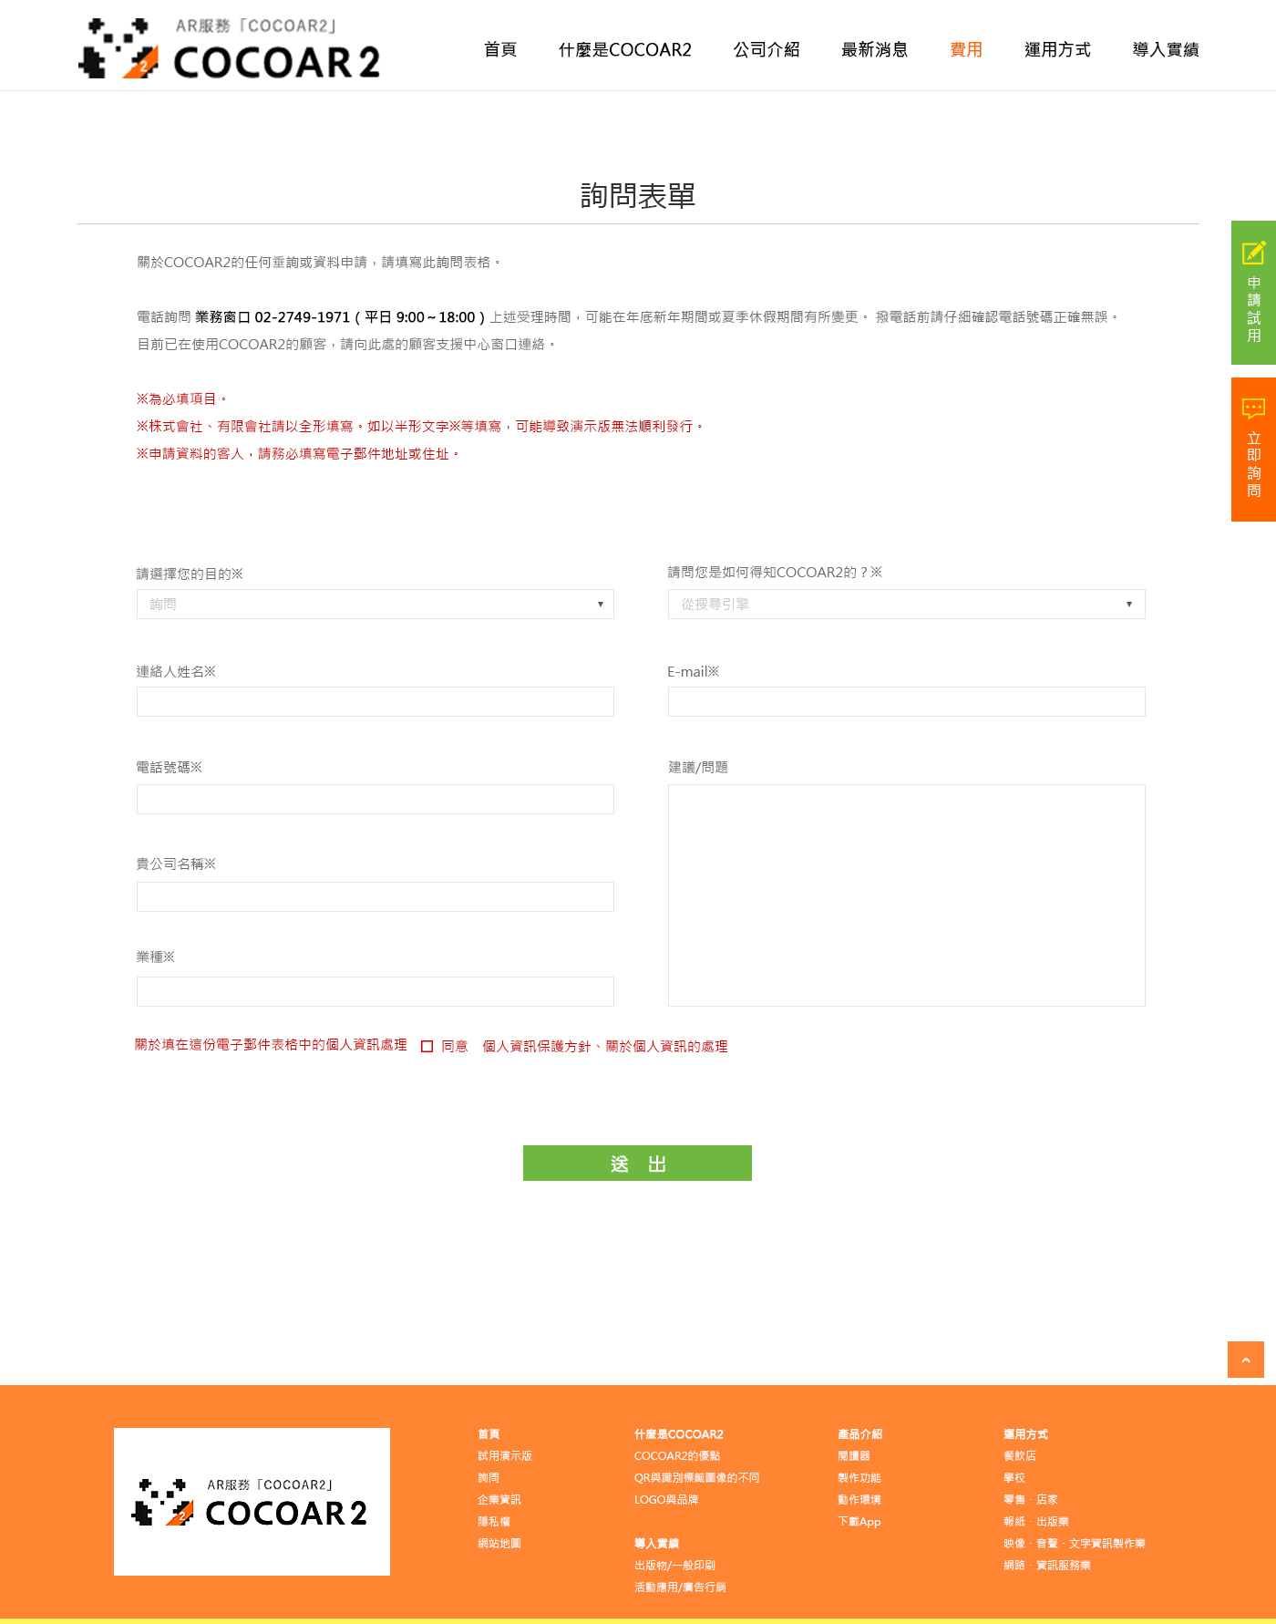
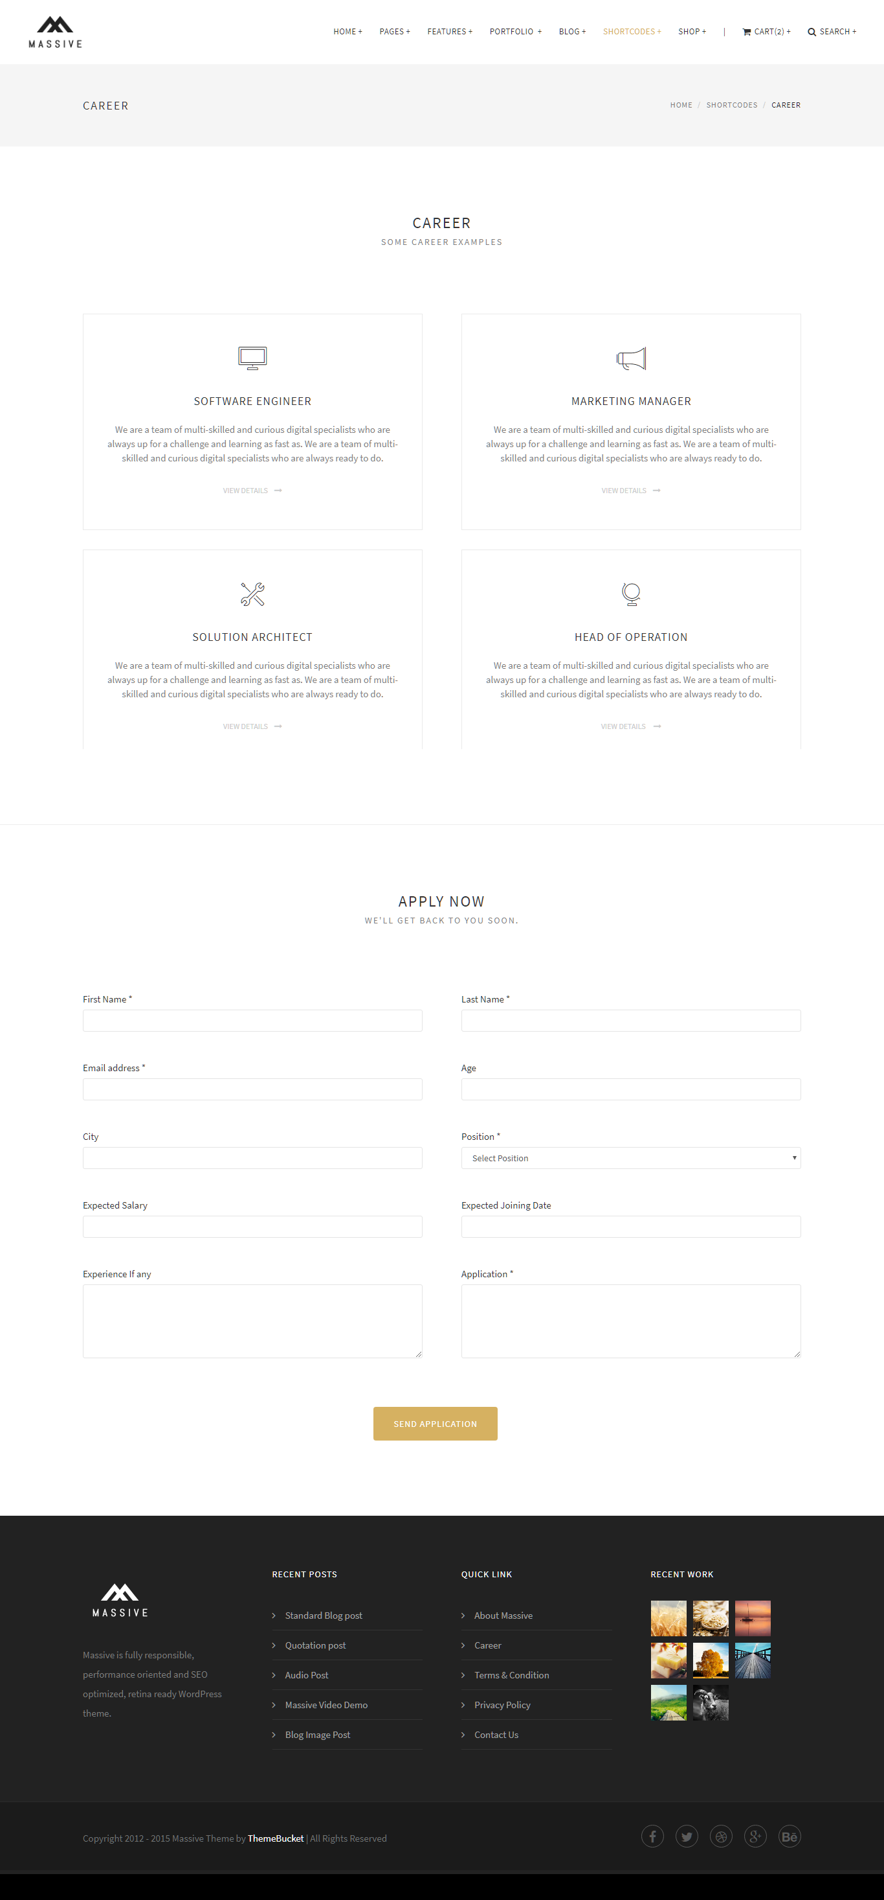
7-1詢問表單
http://massive.markup.themebucket.net/shortcode-career.html

